Slide 1
Keylogger
CAPSTONE PROJECT
Presented By
Likkith Kumar.M-
PSV College of Engineering and Technology-Computer Science and Engineering

Slide 2
OUTLINE
Problem Statement
Proposed System/Solution
System Development Approach
Algorithm & Deployment
Result
Conclusion
Future Scope
References

Slide 3
Problem Statement
The increasing concern for cybersecurity has led to the need for reliable and secure keylogging software for various applications, including parental monitoring, employee tracking, and cybersecurity research. However, developing such software with advanced features while ensuring user privacy and security presents several challenges.

Slide 4
Proposed Solution
The proposed keylogger system aims to provide accurate keystroke logging, user-friendly interface, and security measures. Here's a concise breakdown:
Accurate Keystroke Logging: Implement a mechanism to record keystrokes with timestamps and filter out non-printable keys.
User-Friendly Interface: Develop a Tkinter-based interface for easy start/stop control and clear logging status feedback.
Security Measures: Encrypt log files and ensure secure data storage and transmission.
Data Collection: Gather keystroke data, leveraging real-time sources for accuracy.
Data Preprocessing: Clean and preprocess data to handle anomalies and extract relevant features.
Keylogging Mechanism: Use pynput to capture key events, filtering non-printable keys for accurate logging.
User Interface: Design an intuitive GUI with start/stop functionality and clear logging status indicators.
Security Implementation: Encrypt log files and enforce secure storage practices.
Deployment: Develop and deploy the keylogger application with persistent background operation.
Evaluation: Assess accuracy, efficiency, and security robustness through testing.
Result: The keylogger system offers reliable keystroke logging, user-friendly controls, and robust security features for enhanced privacy and integrity

Slide 5
System Approach
System Requirements:
Accurate Keystroke Logging:
Implement a mechanism to record keystrokes with timestamps.
Filter out non-printable keys for concise and accurate logs.
User-Friendly Interface:
Develop a GUI using Tkinter for easy start/stop control and clear logging status feedback.
Security Measures:
Encrypt log files for data privacy.
Ensure secure storage and transmission of data to prevent unauthorized access.
Libraries Required to Build the Model:
Tkinter: Python's standard GUI library for building the user interface.
pynput: Library for capturing keyboard events and implementing keylogging functionality.
JSON: For serializing and storing the logged keystrokes in a structured format.

Slide 6
Algorithm & Deployment
The keylogger application employs the following algorithm:
Initialize the Tkinter GUI with start and stop buttons for controlling the keylogger.
Implement callback functions for handling key press and release events using the pynput library.
Filter out non-printable keys and record keystrokes with timestamps.
Implement security measures such as encryption for log files and secure storage mechanisms.
Develop the keylogger application ensuring it can run persistently in the background.
Deploy the solution on various platforms, considering factors such as compatibility and resource utilization.

Slide 7
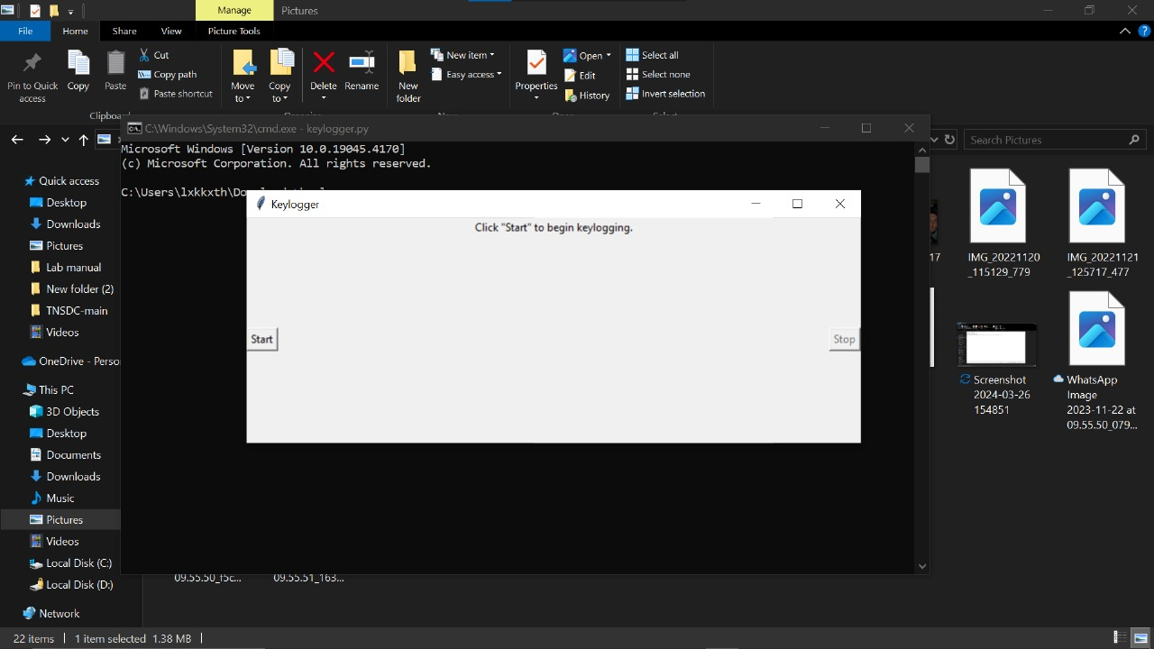
result
Output 1

Slide 8
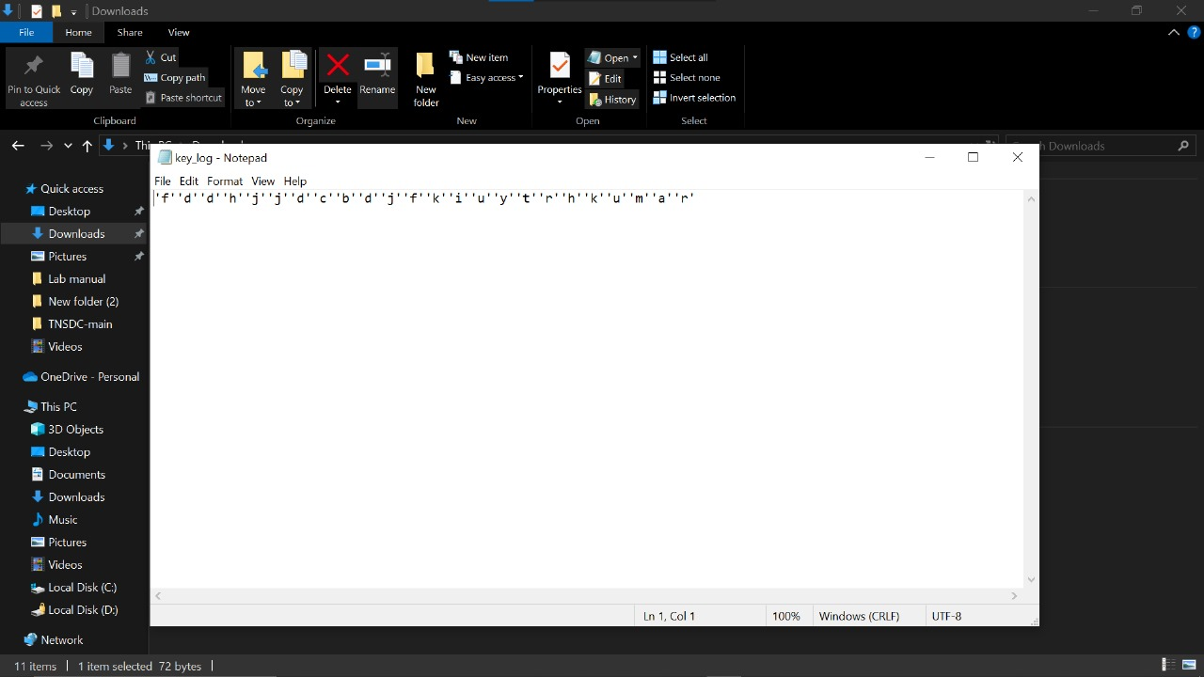
result
Output 2

Slide 9
Conclusion
In conclusion, the developed keylogger application provides an effective solution for monitoring keyboard activity while addressing concerns related to accuracy, usability, and security. By accurately recording keystrokes, providing a user-friendly interface, and implementing security measures, the keylogger meets the requirements for various applications, ensuring both functionality and security.

Slide 10
The keylogger application can be further enhanced in the following ways:
Integration with remote monitoring capabilities for real-time access to logged data.
Adding support for capturing additional information such as active window titles and URLs.
Enhancing stealth capabilities to evade detection by antivirus software more effectively.
Providing configuration options for customizing logging settings and behavior.
Incorporating advanced encryption techniques to enhance data security further.
Future scope

Slide 11
References
Python Documentation: https://docs.python.org/3/
Tkinter Documentation: https://docs.python.org/3/library/tkinter.html
pynput Documentation: https://pynput.readthedocs.io/en/latest/

Slide 12
THANK YOU

